Slide 1
Robot design
Oscar overall, pijus asaciovas, truben latrinco

Slide 2


Slide 3
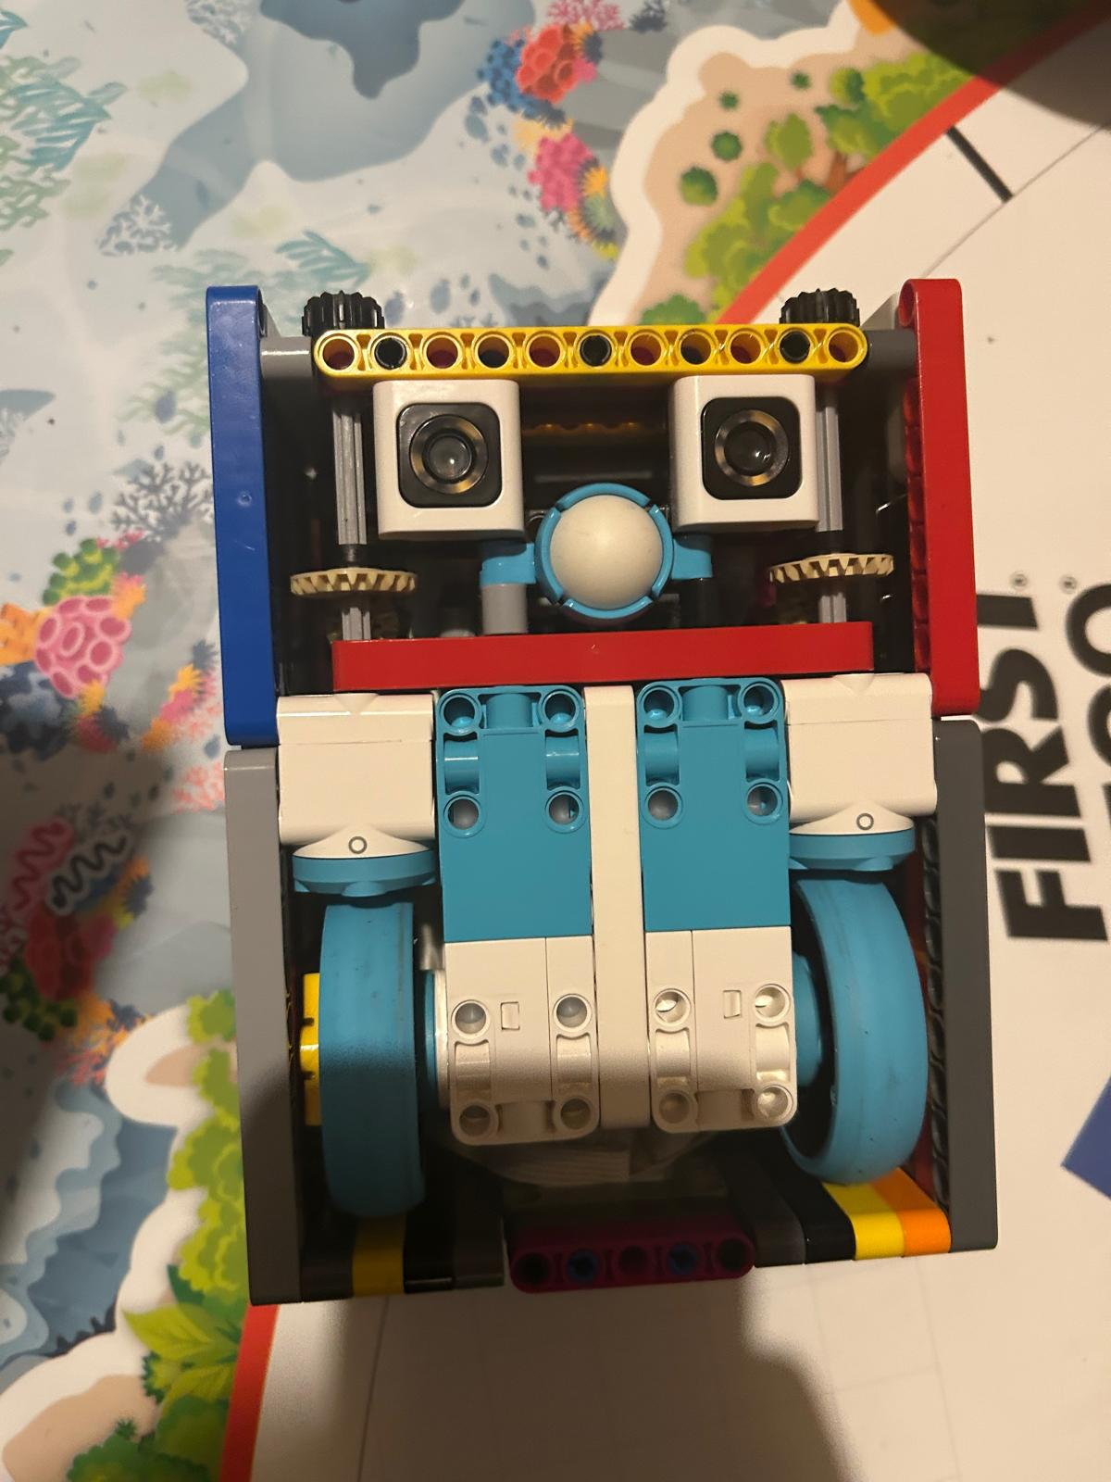
Old robot
Long and thin shape makes turning inaccurate and puts excess strain on the motors making turns inconsistent.
Dual light sensors
Pros:
Allow for extremely accurate line following
Ability to square on lines
Cons: - close distance makes line squareing tempermental
Gears that allowed attachment motors to power front and top attachments but limited access to the front of robot for attachments to lie
Spike prime wheels
Pros:
Small
Cons:
Easily dirtied
Dirt lowers grip

Slide 4
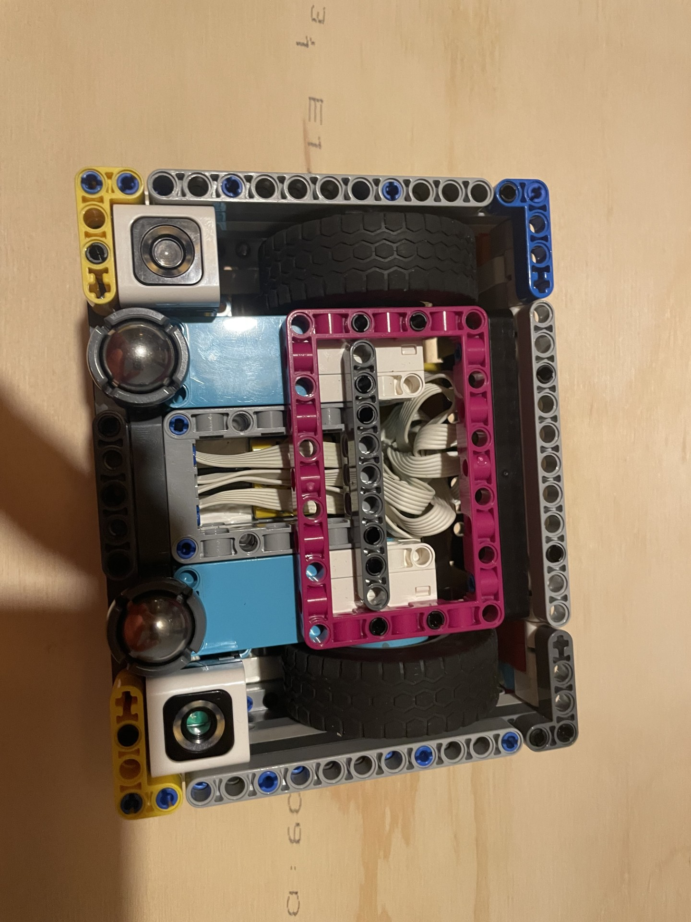
New robot
Light sensors are further apart allowing for more accurate line squaring but less accurate line following. We made this trade as there arent many lines to follow
We have changed to wheels to the rubber tire ones as last year on of the struggles was the spike prime wheels attracting lots of dust preventing grip. New wheels allow for incredible traction
Switched back to castor balls to improve turning
Wide and short form factor allows for great turning precision whilst still keeping a minimal footprint

Slide 5
Mission strategy
Our mission strategy this fll season has been to identify easily achievable missions that are close together and can be achieved using the same attachments
Our goal was to achieve the highest points per second by improving our accuracy as well as designing our attachments to be as frictionless to put on and take off making for faster mission transition times
Our attachments have been designed with these things in mind as well as the mission strategy

Slide 6
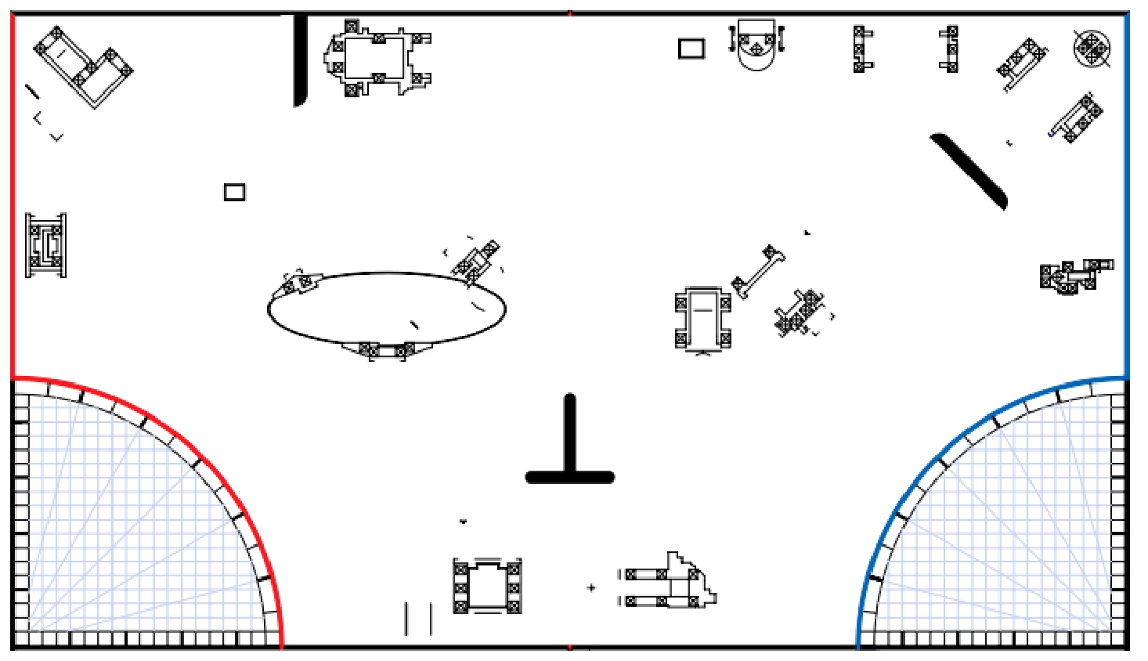
Mission strategy
Route 1 (80pts)
Route 2 (30pts)
Route 3 (30pts)
Route 4 (10pts)
Route 5 (80pts)
Route 6 (30pts)

Slide 7
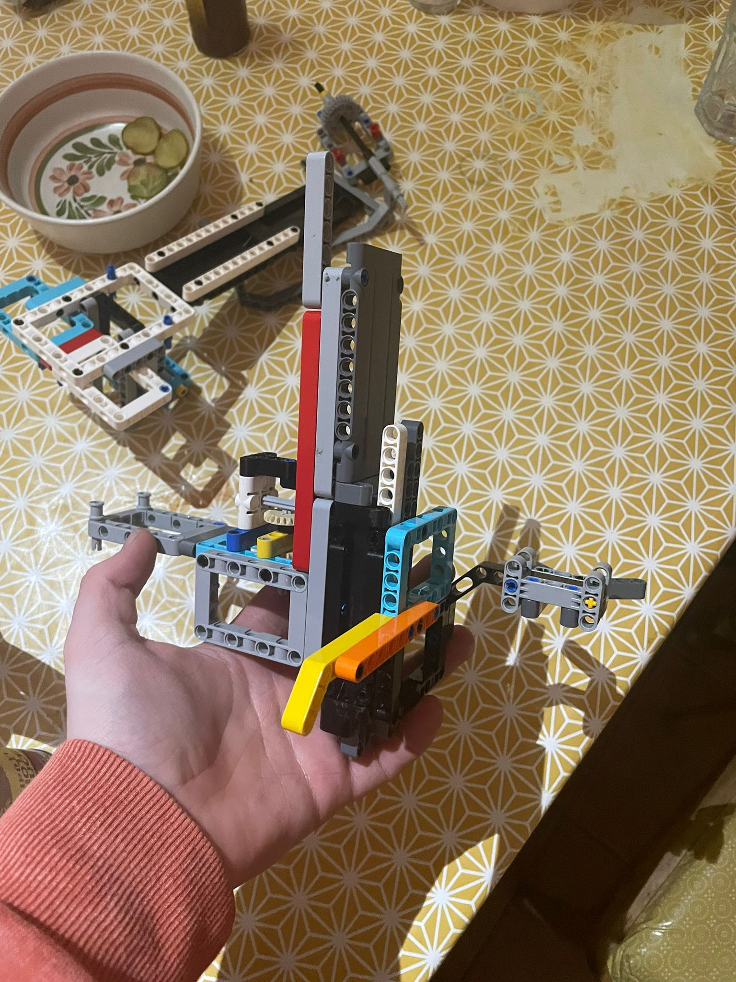
Creator: Oscar
Rack and pinion to convert rotational motion into linear motion allowing us to pick up a variety of things
Pick up sweep
To raise the cart and pick up grass

Slide 8
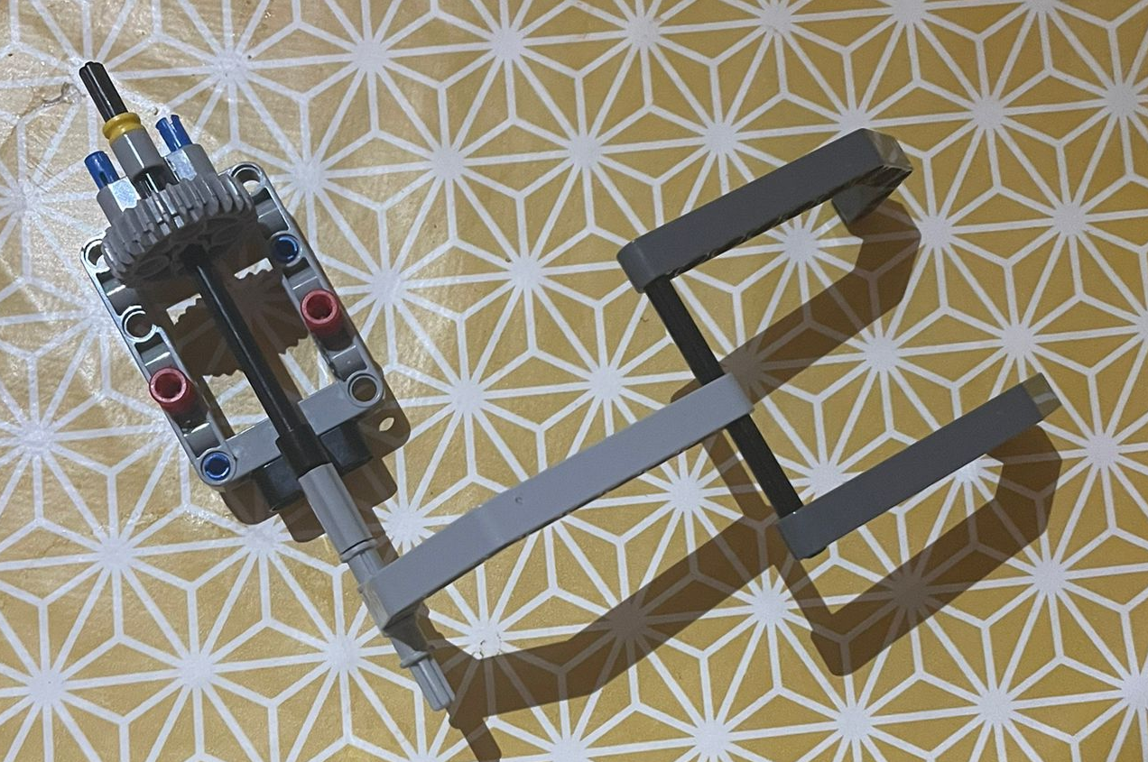
Creator: ruben
Claw spread apart to increase Margin of error when clearing the sand

Slide 9
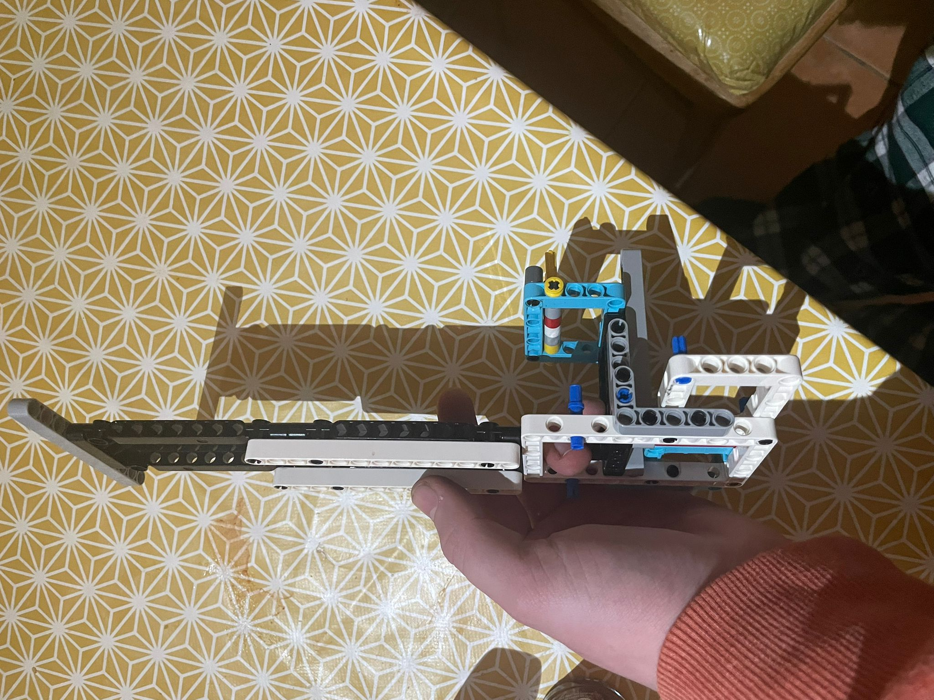
Creator: ruben
One way gate to collect the cart without using a motor
Long arm to tip the scale

Slide 10
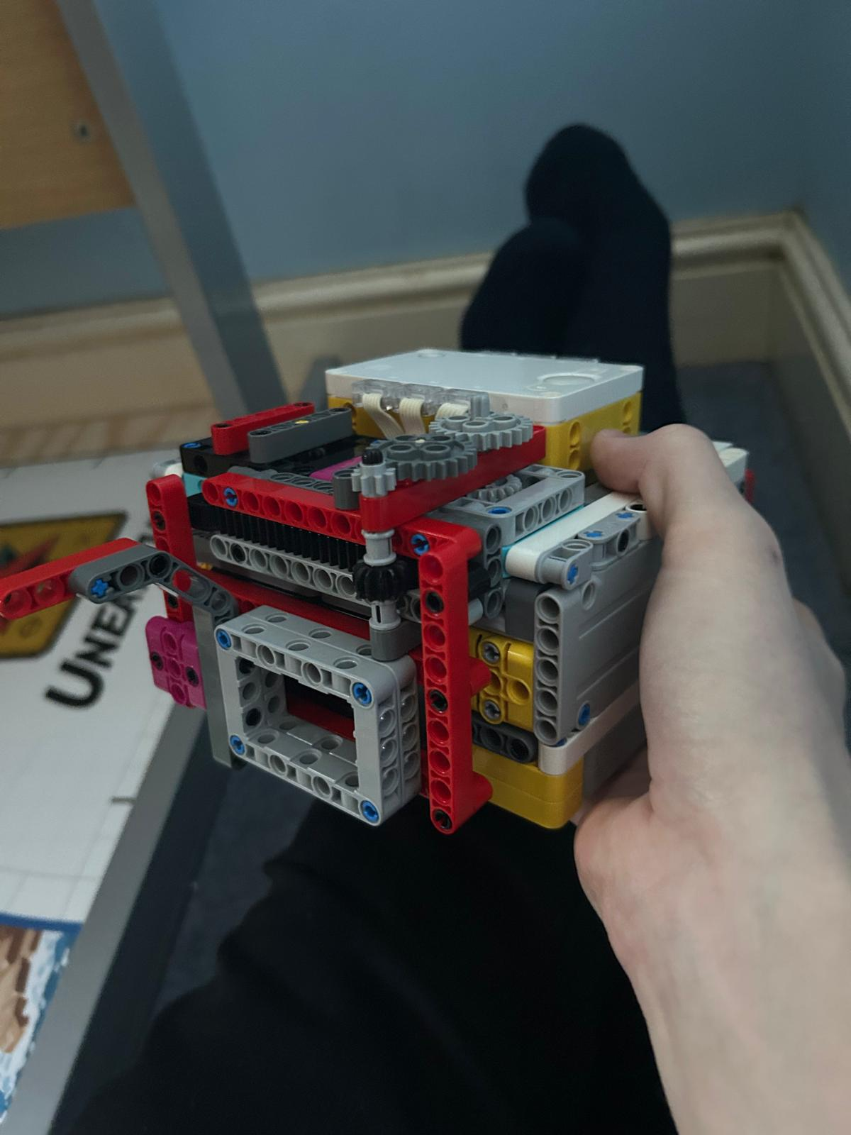
Creator: oscar
Rack and pinion to convert rotational motion into linear motion
Front arm to complete the boulders and flip the dig site
Completes 2 outings

Slide 11
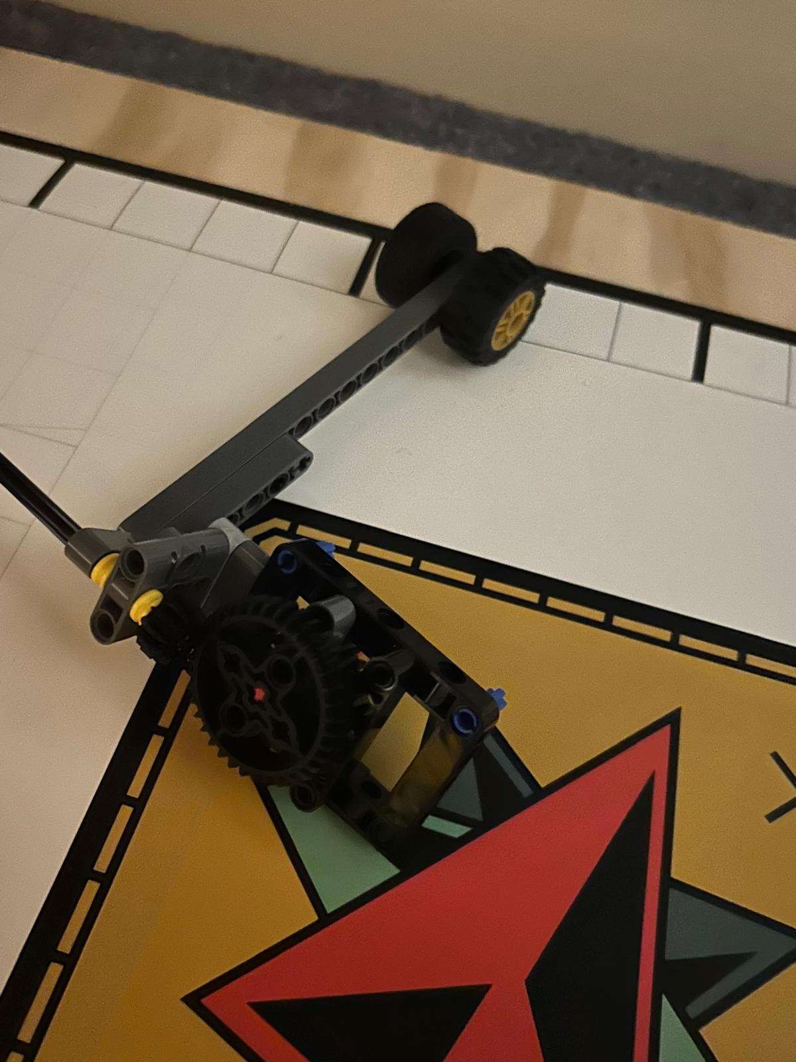
Creator: pijus
Tires to increase weight and force of hits
Gear reduction to increse speed and decrease tourque, attaches to both gears to help with tourque
Completes silo mission

Slide 12

The switch to pybricks

Slide 13
Programing.

